Slide 1
VISIT Weekly Update
Somesh Pratap Singh

Slide 2
Meeting 1
25 May 2023

Slide 3
Lookup and exploration for the technique!
Looked up for various ML optmization algorithms.
With objective function (some ideas to propose?????)
Without objective function
When we don’t know the objective function, I can go with a supervised model and come back and check at lab for the new data entries….heavily depends how feasible our experiment is? Since the data points are less!
Are things directly proportional so that I can go on to define objective function as something like the sum of three characterisation outputs?
Or in general I plan to look onto what are the ways in which I get to choose objective function? I might hit a technique for the same.

Slide 4
Settling on BO?????????????????????
If we have access to dataset and want to optimize some aspect of it, we can frame the problem as a surrogate modeling and optimization task.
But, some aspect? And in all the videos that I have seen till now the data dealt was 1-D.
So, should I apply BO for each of all the combinations possible? And would have to look up ways to combine the individual results.

Slide 5
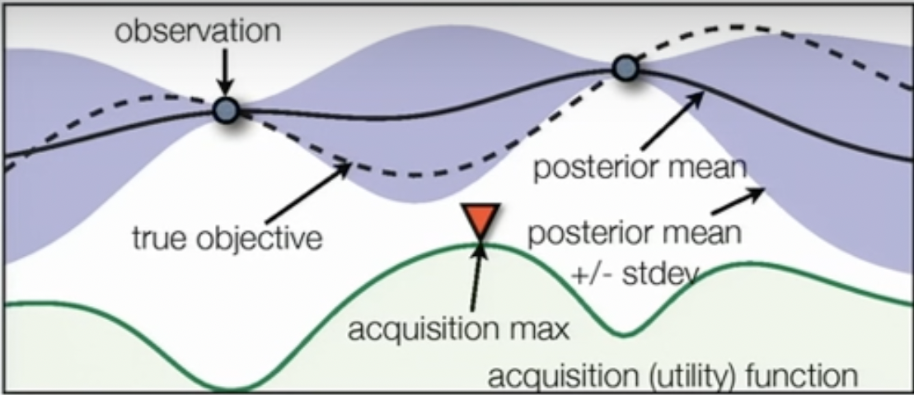
What is BO and how do we go on implementing it?
Reference: Machine learning - Bayesian optimization and multi-armed bandits

Slide 6
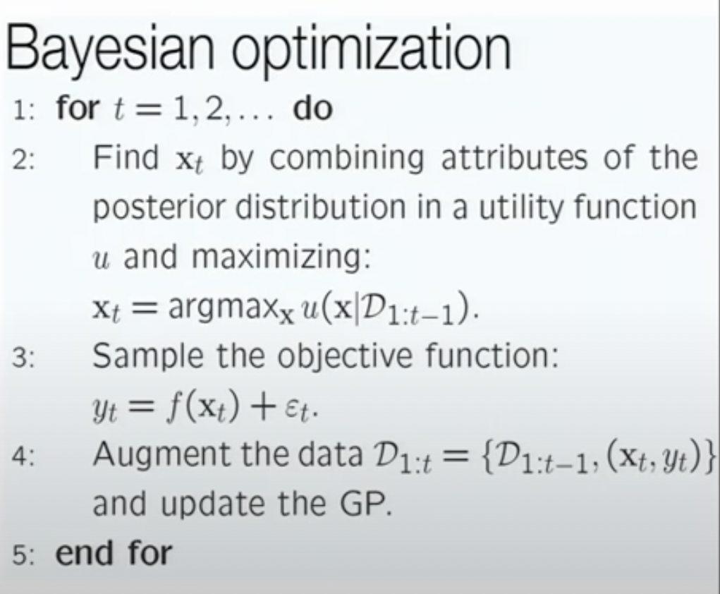
BO Algo
Reference: Machine learning - Bayesian optimization and multi-armed bandits

Slide 7
Things to do next
Learn about acquisition function.
Learn about Gaussian processes in detail.
Apply BO to one input attribute and one prediction.
Lookup literature on how to combine results from individual optimizations OR can we apply this BO to multi-dimensional data (I am quite sure there is a way!!)
Look up for how to construct objective functions (ES654, CS328).
Lookup the literature for application of BO for similar problems.
—---------------—---------------—---------------—---------------—---------------—---------------—------------a. Make a timeline..once I have the structure in mind.
Read about the actual physics/chemistry of the problem.

Slide 8
Ankush Bhaiya Questions
Should we deconvolute from the high-res spectra or would the survey spectra work? (13 coupons)
Should I do the experiments for contact angle and surface roughness?

Slide 9
Meeting 2 (slides made after Meeting)
30 May 2023

Slide 10
Points mentioned
I mentioned that I looked for various ML algorithms.
Discussed the need for an objective function and how can we come up with one.
We discussed the most rudimentary form that we can come up with
XPS = A1*SOD + A2*Passes + A3/Speed
We can give less priority to contact angle at this point since there is a high chance that it is a function of XPS and Surface Roughness.
Start by applying BO to relate one processing parameter with XPS. Although, this might not be additive to the final relation but something good to start with to gain familiarity with ML algorithms.
Our main aim is ‘To minimize the paint removal area’.

Slide 11
Points mentioned
Asked Professor about
Starting with linear regression, Professor mentioned, and I also recognised that we don’t have enough data for it. There is also a possibility of trying for Polynomial regression.
I mentioned that I tried linear regression but did not get coefficients. This might be due to any of these two reasons:
Small dataset
Maybe I did not apply the backward and similar things on the dataset.
I mentioned that I tried fitting GP, the model fit on whatever the dummy data I had, but I was not able to get the equation of the curve.
If we are to get the equation only, then Prof and I jointly questioned why we need the Bayesian Optimisation and how it is different from Linear regression and other regression models. I then mentioned how BO is applied in that UBC youtube video, but how is the implementation done on the scikit learn website? There is no iterative aspect on the scikit learn website.
In continuation to this, Professor shared an article which had the implementation of the BO.
We then discussed the dimensionality of the data that can be fed to a BO code. With reference to that Professor asked one of his students to share a code who mentioned that he had seen BO code for 64 dimensions.
One important thing sir mentioned was that we have three things:
Processing parameters
Surface properties
Final scratch test
Our aim is to link processing parameters to the final scratch test (0-1 value). The link to the surface properties is the from properties is the physics of the problem and that is the secondary objective of our problem.
I asked about the safety training to which Prof. answered that I do not need to do the training. Also mentioned about the table and after which I got a desk in G042:)

Slide 12
To do after this meeting (Actually two short meetings)
Look at the data carefully and see what you can get from there.
Go through the ML website.
Go through the code sir shared
Make a decision tree on paper | cancel
Look up decision tree | d
Look up random forest |
Linear regression (backward thing)
Polynomial regression
Fitting equation using GP, getting the parameters of the equation (the thing sir shared) | w
One input and one output prediction (get a working code)
LITERATURE SURVEY | w
Y as a function of all the processing parameters. Look up this thing, how to do it in literature.
Look up GP (optional)
Look about objective function

Slide 13
Meeting 3
5 June 2023

Slide 14
Points to mention
Talk about the nature of input data
Talk about the not-continuos but P/F data
Implemented decision tree
Boeing Question Ankush told and building model for that.
Intuition based prediction on decision tree
Mention about paper Ankush mentioned
Started scanning the ML course directory
Random forest
Mention about the overfitting issue of decision tree

Slide 15
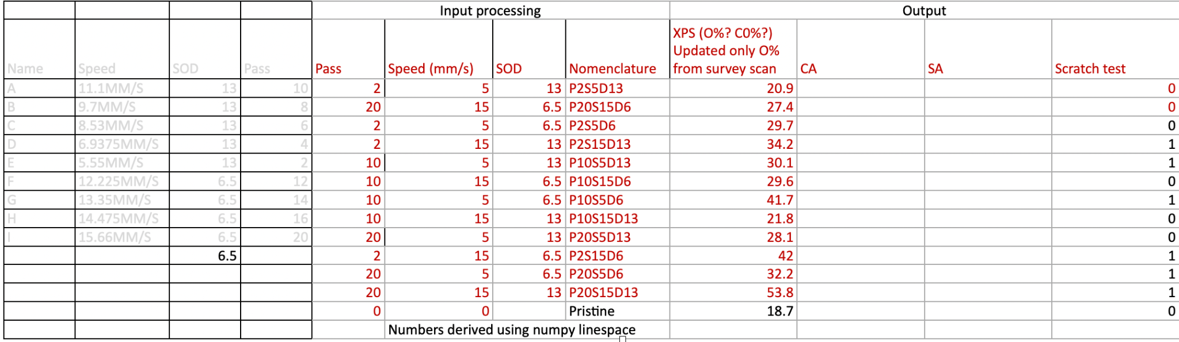

Slide 16
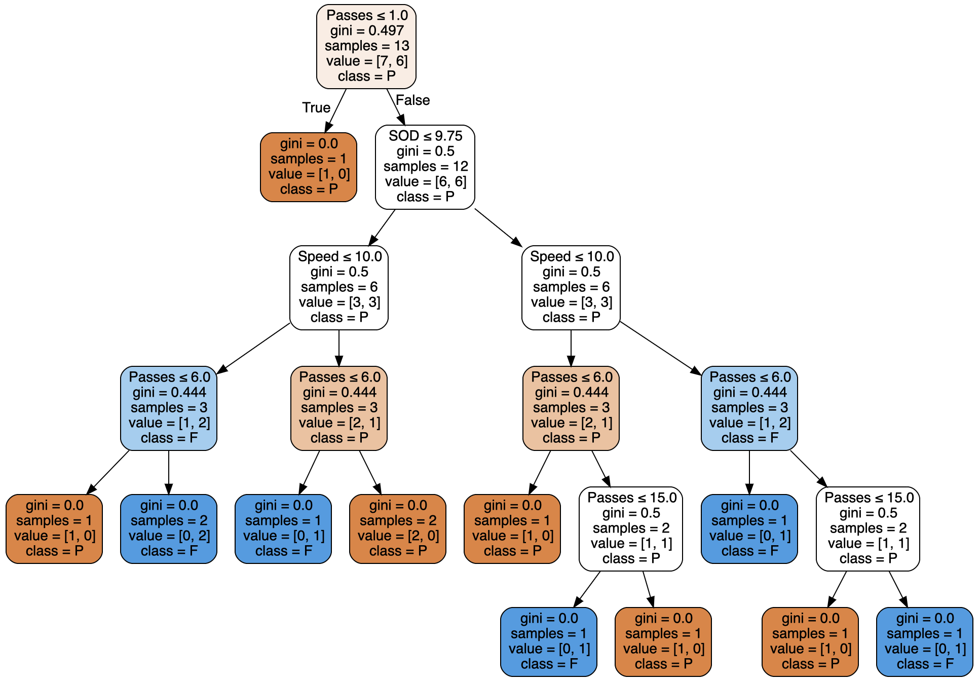

Slide 17
Logistical questions
Meeting times (preferably Tuesday and Friday)
Second project

Slide 18
Meeting 4
9 June 2023

Slide 19
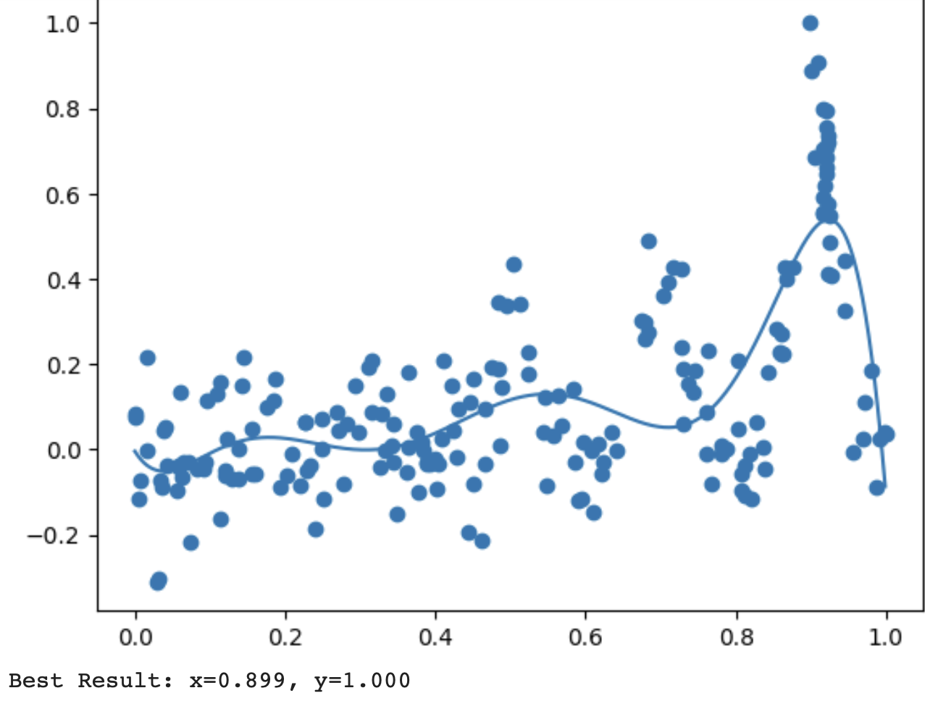
Implementation for BO for 1-D data
Colab Link: https://colab.research.google.com/drive/1dUaPzwemCjHg2hgXsc0UJ-65JqK0PE-j?authuser=4#scrollTo=2kl0NMjUTEAj
Sample data: Sine with noise (just for illustration)
Found an iterative implementation which was coherent with the theory I learnt.
Earlier, we were just learning some curve and then applying gp_minimize
Steps:
Fit a surrogate model
Ask the acquisition function for next point
Add that point to the data and fit a GP to these points
Keep a track of the acquired (x,y) and report the x for maximum y.

Slide 20
BO for our 3D data
We can just define the input as an array with 3 attributes. Colab Link
Steps:
Rudimentary Objective Function to capture the trend
Fit surrogate to the data
Use acquisition function to find the next combination of x1, x2, x3 which we would include in our data to fit the next model
As we acquire more data points, we move to a closer approximation of the objective using the surrogate.
Keep track of the all the values and report the maximum.
Could not plot the curve unlike we have done for 1D data before!

Slide 21
Meeting 5
19 June 2023
DoE Doc

Slide 22
Intuition based predictions on decision tree
This analysis is based on intuition that
Trying for the worst case of
1. Speed (15) and SOD (13): Number of passes for which it passes = 16
2. Number of Passes (1) and Speed (15): Fails for both SOD values
3. SOD (13) and Number of Passes (1): Test passes for no value of speed
Colab link

Slide 23
Meeting 6
21 June 2023
Discussed the realisation that we have to parallely evaluate and supply datapoints to the model rather than getting all the datapoints once and then giving it to the model as input. Was an unplanned meeting so could not prepare PPT

Slide 24
Meeting 7
26 June 2023

Slide 25
Things to discuss
Wet tape test and dry tape test image analysis results
GP and the choice of
Mean function
Kernel function
Acquisition function
Types
Exploration/Exploitation trade off
New acquisitions
Gpy-opt package for BO
Reference manual
Externally evaluating objective function

Slide 26
Wet tape test and Dry tape test results
Things to note:
Almost all of them are in the same range we can not be sure whether the difference is really due to chemistry or can be human error.
Dry tape test: Pristine does perform bad (discussed earlier)
Wet tape test: Pristine performs better than some of the samples
Do we need CA and SA both values for further data or only one would work?
Coupon# | Passes | Speed (mm/s) | SOD | %Area Dry Tape Test | %Area Wet Tape Test
1 | 2 | 5 | 13 | 91.853 | 94.923
2 | 20 | 15 | 6.5 | 90.393 | 93.924
3 | 2 | 5 | 6.5 | 93.208 | 92.303
4 | 2 | 15 | 13 | 91.742 | 89.844
5 | 10 | 5 | 13 | 95.125 | 92.345
6 | 10 | 15 | 6.5 | 95.185 | 93.981
7 | 10 | 5 | 6.5 | 94.079 | 93.2
8 | 10 | 15 | 13 | 93.418 | 93.254
9 | 20 | 5 | 13 | 92.761 | 94.526
10 | 2 | 15 | 6.5 | 90.722 | 93.158
11 | 20 | 5 | 6.5 | 94.974 | 93.483
12 | 20 | 15 | 13 | 92.296 | 91.282
Pristine | na | na | na | 88.53 | 93.944

Slide 27
Gaussian Processes (placing prior over the unknown objective)
GP is accepted for placing prior (we will not explore other methods).
For convenience, in the tutorial they have taken prior mean to be zero there are other methods too [Martinez–Cantin et al., 2009, Brochu et al., 2010a]].
More interesting choice is the covariance function.
Popular one: Squared exponential kernel
Most of the GP kernels are discussed at these two sources in detail (haven’t gone through them)
Scikit learn
MIT GP book chapter 4 (cited at many places)
We should tune this as well ????
Researching on this would take time
Not every thing we custom might be intagrable with the source packages available

Slide 28
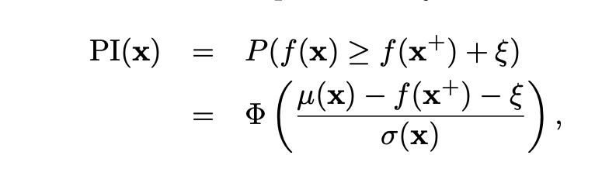
Acquisition Functions
Probability of improvement
“The difficulty is that [the PI(·) method] is extremely sensitive to the choice of the target. If the desired improvement is too small, the search will be highly local and will only move on to search globally after searching nearly exhaustively around the current best point. On the other hand, if [ξ] is set too high, the search will be excessively global, and the algorithm will be slow to fine-tune any promising solutions.”

Slide 29
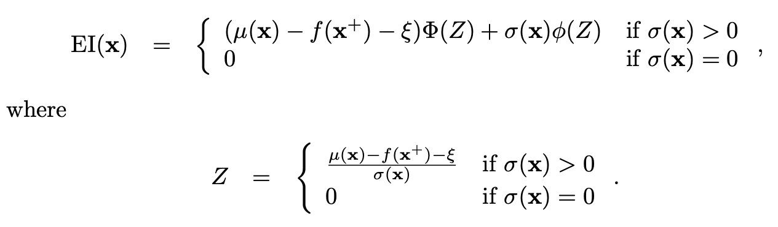
Acquisition Functions
Expected improvement
Takes into account not only the probability of improvement, but the magnitude of the improvement as well
Minimize the expected deviation from the true maximum f(x⋆), when choosing the next trial point.
Psi is similar to PI, Lizotte suggested that psi = 0.01 works well for almost all the cases. Cooling schedule does not always work, although against intuition.

Slide 30
Other Acquisitions
Upper confidence bound (implemented)
Entropy search
Knowledge gradient

Slide 31
Which acquisitions to choose?
It is difficult to choose which to use and the papers that I went through just defined what each of them does.
There is also one method for utility selection which uses different acquisition for different stages. Brouchu et al. proposed this in 2010 and claim that it outperforms using the individual acquisitions.

Slide 32
Gpy-opt: BO implementation package
Has capabilities for multi-dimensional data
Supports external evaluation of objective function, as is our case
Also supports:
New prior placing methods (if we want custom mean and covariance for GP)
If we want to use any of the new acquisition functions

Slide 33
Next steps
Try the simplest implementation and give the datapoints to Ankush as earliest.
Search on GP kernels and means
Look into the implementation of Brochu et al., 2010 acquisition function technique
IF, we can get any paper that gives where to use which acquisition function.
Difficult, but, would try to give reading by Friday, because giving the first suggestion would require full implementation after which it would not be much of a task.

Slide 34
Meeting 8
30 June 2023

Slide 35
Things to discuss
Code explanation
Discuss about the domain
Initial dataset (Dry tape test)
BO object explanation
Show a demo, adding a new point and then rerunning
The next suggested point is based on a different composite and we would be trying for a new PEEK composite now.
Length and breadth of the new samples
PEEK accelerated cure
PEEK DoE

Slide 36
Things to discuss
Dry and wet tape test results for PEEK sample
Improving on the implementation
Stopping criteria
Avoiding local minima
Multiple re-runs and restarts
Literature survey (place the reference not the link !!!!!!)
NS paper
Pharmaceutical paper
Other papers (went through abstract only till now)
Li, C., Rubín de Celis Leal, D., Rana, S., Gupta, S., Sutti, A., Greenhill, S., ... & Venkatesh, S. (2017). Rapid Bayesian optimisation for synthesis of short polymer fiber materials. Scientific reports, 7(1), 1-10.
Kumar, P. V., & Jin, Y. (2023). Bayesian Optimisation for Efficient Material Discovery: A Mini Review. Nanoscale.

Slide 37
Code explanation : Defining the domain
Number of passes can take only integer values, we define it as a discrete variable that can take 25 discerete values i.e., the integers in the range 1 to 25
Similar to number of passes, the resolution we have available for speed (in mm/s) is 0.5, so we define this also as a discrete variable that can take 31 distinct values in the range 0.5 to 15.5varying at an interval of 0.5
SOD is also a discrete variable that takes two values: 6.5 and 13 (or we have the freedom, should I also increase the number of values for it)

Slide 38
Code explanation: BO object
bo_step = GPyOpt.methods.BayesianOptimization
(f = None, domain = domain, model_type='GP',
X = X_updating, Y = Y_updating, initial_design_numdata=12,
acquisition_type='EI', exact_feval=False, maximize=True)
We then use the method - bo_setp_suggest next location
Demo

Slide 39
Literature survey
NS paper
Conform on how did we get the initial data?
Had an objective function
We stop when the error does not decrease anymore, how does that guarantee a global minima, did we have multiple re-runs and restarts.
Pharmaceutical Paper
Do a DoE for initial dataset (best if widely distributed in input space) and then BO to capture further interactions rather than carrying out more experiments.
Instead of GP they use Linear regression
They found PI performing best for their data
Rapid Bayesian optimisation for synthesis of short polymer fiber materials
EI
Multiple runs (each with 20 iterations) each with five starting points
They did not have a stopping criteria but they had a target and defined an score for how far were they from the target

Slide 40
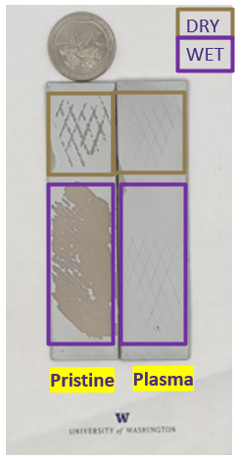
Dry and wet tape test results for PEEK sample
Parameters for plasma treatment | Flow rate: 46L/min | RPM:2800 | SOD: 13mm | Translating stage speed: 11.1mm/s
PEEK/Dry/Pristine | 84.952
PEEK/Dry/Plasma-treated | 96.747
PEEK/Wet/Pristine | 26.528
PEEK/Wet/Plasma-treated | 99.07

Slide 41
Steps ahead
Search literature related to
Stopping criteria
More papers like “Rapid Bayesian optimisation for synthesis of short polymer fiber materials”
Start a sort of literature review for all these BO applications thats we would put in our paper
GP kernels
Look into the source code of GPy-opt
Add some background info slides on gpyopt
Try other prior methods
Design a DoE for PEEK
Look into Active Learning
Write down the sources of error that would affect our decision for f_eval
Discussed the domain for the experiment:
SOD (4 - 15) with each step being 0.5
Speed (0.5 - 15.5) with each step being 0.5
#Passes (integers in the range 1 to 50)
Flow rate (10-85)
Nozzle rpm (1000-2800)

Slide 42
Meeting 9
5 July 2023

Slide 43
Things to discuss
Pending_X and Black_listed_X for ‘suggest next location’
Talk about trying different kind of GPs and RF
Conformed that acquisition function runs with epsilon = 0.01, something they call as jitter
Tried to change it, but there was analytical_prediction True error because we do not have the the objective function
Standard GP uses matern 5/2 kernel

Slide 44
Meeting 10
7 July 2023

Slide 45
Things to discuss
Sources of Error (for f_eval to be set false)
Human error in cropping the image
How you pull the tape?
How did we wrap the samples?
Performance of spray guns?
Time duration between the treated sample and painting
Background information/slides on Gpy-opt
DoE for PEEK
Full factorial (is impossible)
Half Factorial
Taguchi
CCD
Begin intern report? (Do I need to give a short report for the first point suggested or I can include that in the final report because this is the deliverable we will be claiming from our internship)
Sections (Structure of report)
Which section requires how much detail?
Contents

Slide 46
Things to discuss
Discuss evaluation form
List parts of the chronology or syllabus of training or tasks that the intern performed during this period.
Preparing pre-requisites on BO
Literature survey abot existing BO applications
Gain knowledge about DoE
DoE for thermoplastic
1-D BO implementation
BO implementation to our problem
DoE for PEEK
Understanding of the python libraries implementing BO

Slide 47
Things to discuss
Discuss evaluation form
Evaluate the intern’s progress on the specific objectives of this work-based learning experience, including skills that have been developed.
Should I just rate the things written in above answer?
What types of cultural activities did the intern participate in?
FIUTS wednesday lunch
4th July Gasworks park
Intern response (Optional)?
Number of hours?
Do we also need to send Mid term evaluation? Wasn’t asked anytime before and isn’t compulsory?
Thing you were telling about Biochem..continued from last meeting?

Slide 48
Gpy-opt
GPyOpt is a Python open-source library for Bayesian Optimization developed at the University of Sheffield.
Mainly used for:
Tuning ML algorithms
Designing wet lab experiments
Based Gaussian Processes modelling GPy library which is known to be a stable library.

Slide 49
Gpy-opt
Library has received 17 citations since it was published in 2016. These include applications in:
Physical Chemistry [Chan et. al, 2020]
Hyperparameter optimization [Peng et. al., 2019]
Plasma Physics [Knapp et. al, 2023]
And many other project applications

Slide 50
Comparison of Taguchi and CCD
A comparison of central composite design and Taguchi method for optimizing Fenton process
“Taguchi method is a robust statistical tool for experimental design and process optimization. Data analysis and optimization of operating parameters are possible with fewest numbers of experiments, less computational experience”. [Asghar et. al.,2014]
Comparison of Taguchi method and central composite design for optimizing process parameters in vertical double gate MOSFET
Optimized six processing parameters. “The observation of the final results indicates that the Taguchi method is the most suitable statistical tools over the CCD for optimizing the process parameters in the device due to its simplicity (requires less experiment runs) and its efficiency (better in overall device characteristics).” [Kaharudin et. al., 2014]
Which is better for optimizing the biosorption process of lead–central composite design or the Taguchi technique? [Azari et. al, 2016]
Comparison of design of experiment methods for modeling injection molding experiments using artificial neural networks [Heinisch et. al., 2021]

Slide 51
Taguchi Design
Planning to use Taguchi design, P=4 and L = 5
Surface roughness optimization in an end-milling operation using the Taguchi design method
Optimize surface quality in a face milling operation.
“The Taguchi design is an efficient and effective experimental method in which a response variable can be optimized, given various control and noise factors, using fewer resources than a factorial design.” “Finally, confirmation tests verified that the Taguchi design was successful in optimizing milling parameters for surface roughness.” [Zhang et. al., 2006]
Wikipedia
“Many of the orthogonal arrays that Taguchi has advocated are saturated arrays, allowing no scope for estimation of interactions. This is a continuing topic of controversy.”

Slide 52
Central Composite Design
Application of the central composite design and response surface methodology to the advanced treatment of olive oil processing wastewater using Fenton' peroxidation [Ahmadi et. al., 2005]
Application of central composite design to the optimisation of aqueous two-phase extraction of human antibodies [Rosa et. al., 2007]

Slide 53
Steps ahead
Finalise DoE for PEEK
Report?

Slide 54
Meeting 11
11 July 2023

Slide 55
Things to Discuss
DoE for PEEK
Report format
CNT Paper

Slide 56
DoE for PEEK: Various available designs
Finalised on Taguchi Design???
Some other second order designs available for detailed study (after we have done screening of the variables):
3^k-q fractional factorial design
Full factorial
Box Behnken Design
Central Composite design

Slide 57
CCD Vs Taguchi (as per Chatgpt, I searched the same on Google Scholar, Google Search but could not find relevant articles)
The methods listed 1-4 in the previous slide are mostly used when our focus is:
To find the relationship between the output and variables in the input parameter space.
To determine main effects and if interactions are possible
To capture different types of interactions between variables in input space
Optimize response by finding the optimal factor settings withi the experimental region
Taguchi method is used for
Optimisation of product or process parameters
When the focus is on finding the best combination of input factors that minimise variation and achieve desired performance

Slide 58
Taguchi application in optimisation problems
Taguchi has been used in various optimisation problems (Listed in decreasing order of number of citations):
Design optimization of cutting parameters for turning operations based on the Taguchi method [Tarng and Yang, 1998]
Application of Taguchi method in the optimization of end milling parameters [Ghani et. al., 2004]
Taguchi approach to design optimization for quality and cost: an overview [Unal and Dean, 1991]
Application of Taguchi method for optimization of process parameters in improving the surface roughness of lathe facing operation [Athreya and Venkatesh, 2012]
Die casting process optimization using Taguchi methods [G.P. Syrcos, 2003]
AND numerous highly cited papers where they optimize the values for input parameters for a given manufacturing process (cutting, turning, milling)

Slide 59
CCD application in Optimisation problems
Application of central composite design to the optimisation of aqueous two-phase extraction of human antibodies [Rosa et. al., 2007]
Applicability of a novel and highly effective adsorbent derived from industrial palm oil mill sludge for copper sequestration: Central composite design optimisation and adsorption performance evaluation [Lee et. al., 2021]
Optimisation of ozone treatment for colour and COD removal of acid dye effluent using central composite design experiment [Muthukumar et. al., 2014]
Optimisation using central composite design (CCD) and the desirability function for sorption of methylene blue from aqueous solution onto Lemna major [Sadhukan et. al., 2016]
Most of them are less cited. It is the same paramter optimisation as Taguchi.

Slide 60
Comparison between Taguchi and CCD
Which is better for optimizing the biosorption process of lead–central composite design or the Taguchi technique? [Azari et. al., 2016]
A comparison of central composite design and Taguchi method for optimizing Fenton process [Asghar et. al., 2014]
Comparison between Taguchi Method and Response Surface Methodology (RSM) In Optimizing Machining Condition
All of them state Taguchi to be better

Slide 61
Report format
Abstract
Motivation
Problem statement
Introduction
Polymers
Thermosets
PEEK
BO
GP
ACquisitions
Gpy-opt

Slide 62
Report format
Background Work (existing applications of BO, lit survey part)
DoE
For PEEK
For Thermosets
Methods
Plasma Treatment
Painting
Wet and dry tape tests
ImageJ
External Function Evaluation using BO
Suggesting first point
Use of Gpy-opt library in our case
Discussion and Conclusion
Future work

Slide 63
Meeting 12
14 July 2023

Slide 64
Things to discuss
Results of the dry tape adhesion tests
Final DoE for PEEK
LJ

Slide 65
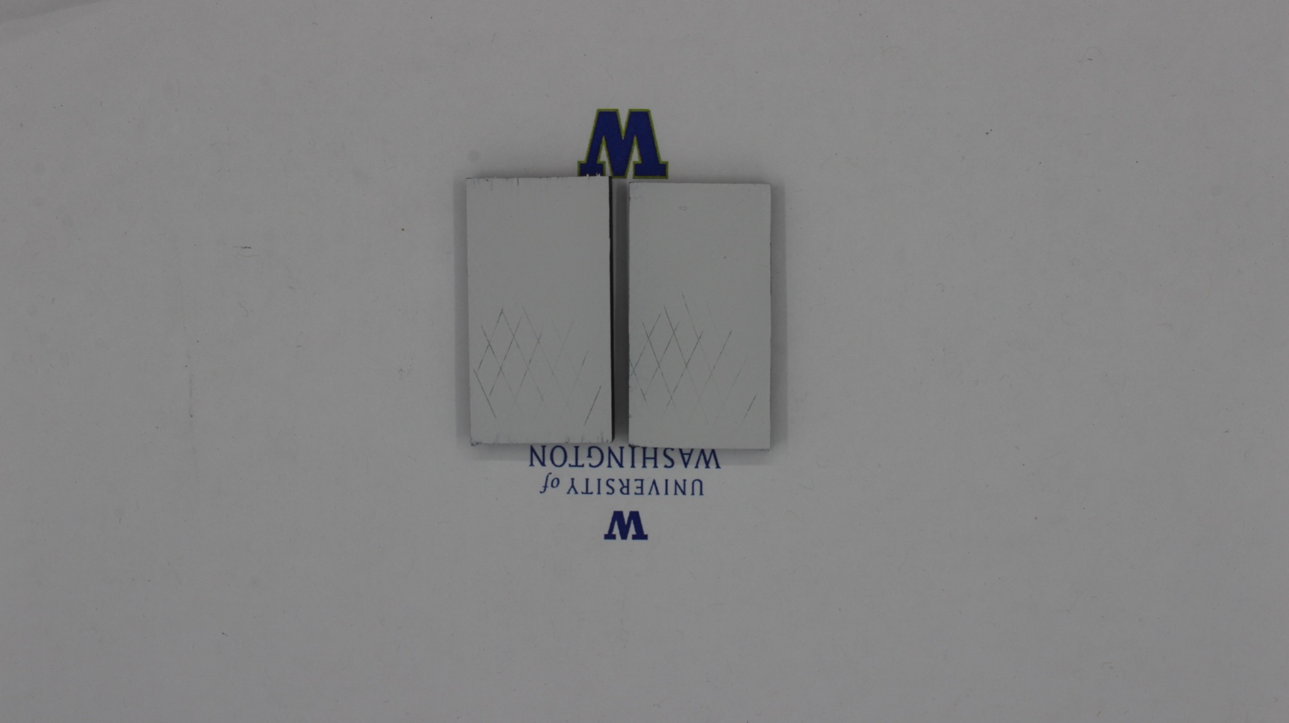
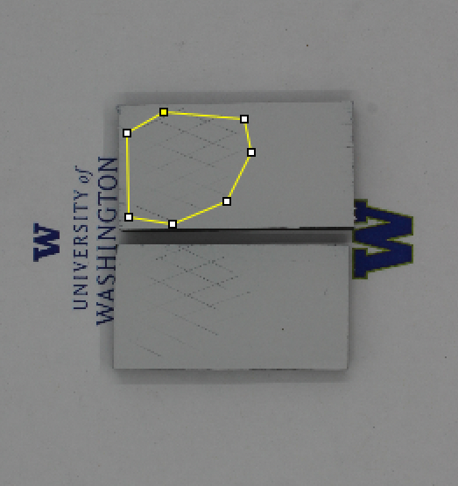
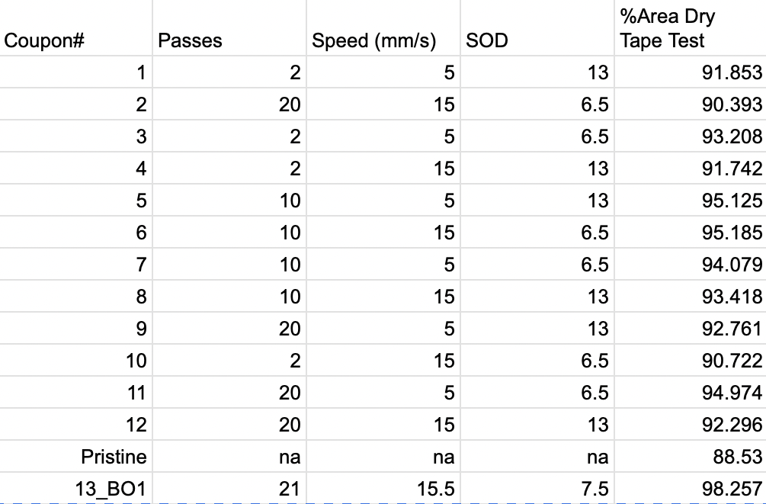
Dry Tape Test Adhesion Results

Slide 66
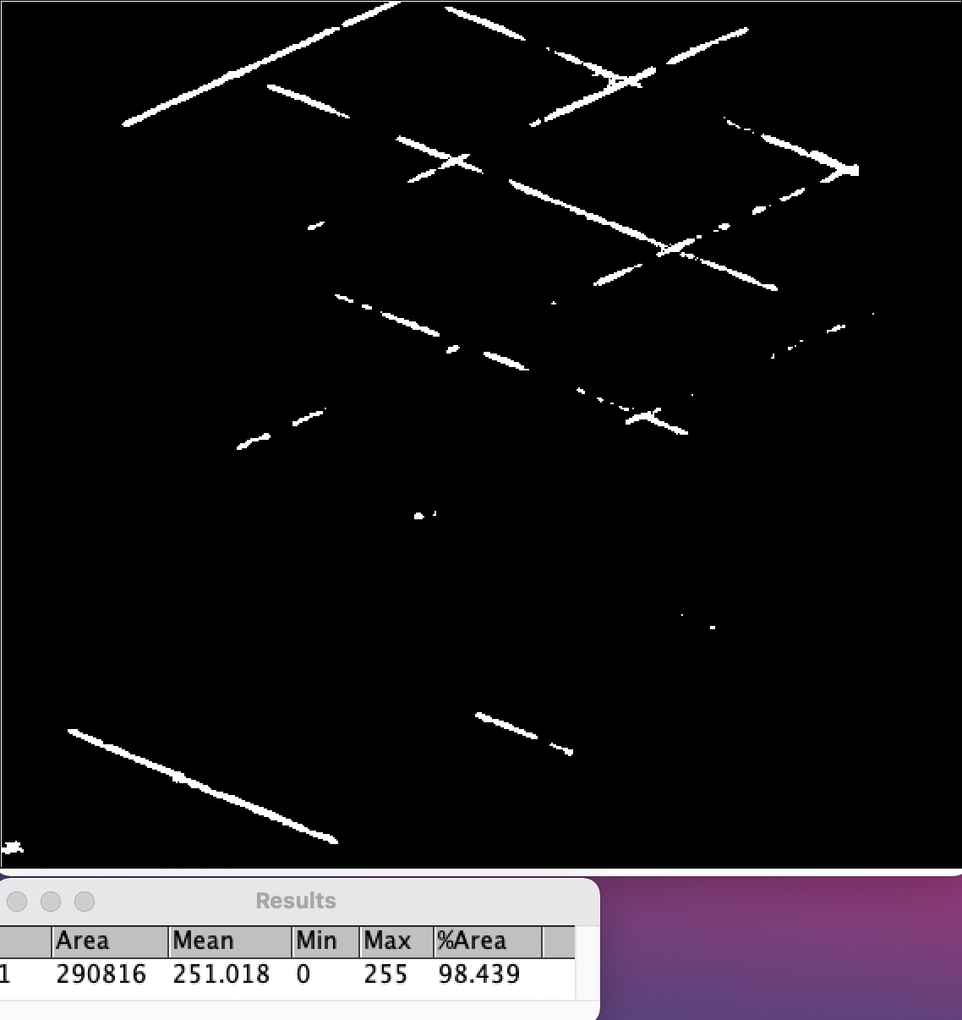
Dry Tape Test Results

Slide 67
Final DoE for PEEK
Taguchi Design
P=4, L=5
Sano et. al., claim that BO requires less number of experiments if the initial learning data is ‘small’ and ‘widely distributed in the parameter space’.
To enforce above point, we have taken linearly spaced points in the space.
RPM would be a multiple of 100? Or any integer
Amongst CCD, and others, Taguchi gives us the most flexibility to give inputs from a wide range of parameter space as we desire.
Sobol is another sequence, been known to be used but we do not have freedom to give points. Tried this as well.

Slide 68
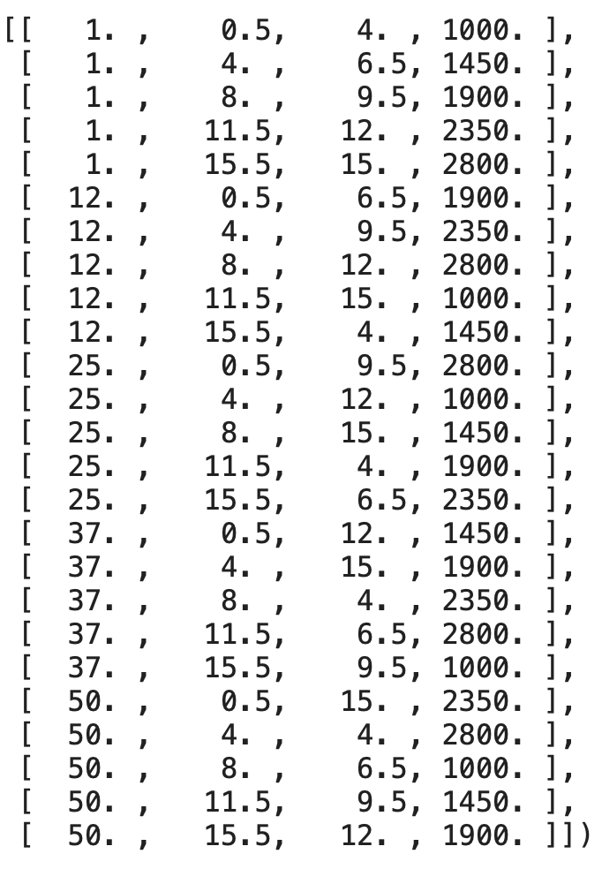
Taguchi Design for our problems

Slide 69
Meeting 13
18 July 2023

Slide 70
Things to discuss
9 point PEEK DoE
Report progress
Contact angle and surface roughness data
New suggestion on every rerun
Lammps error

Slide 71
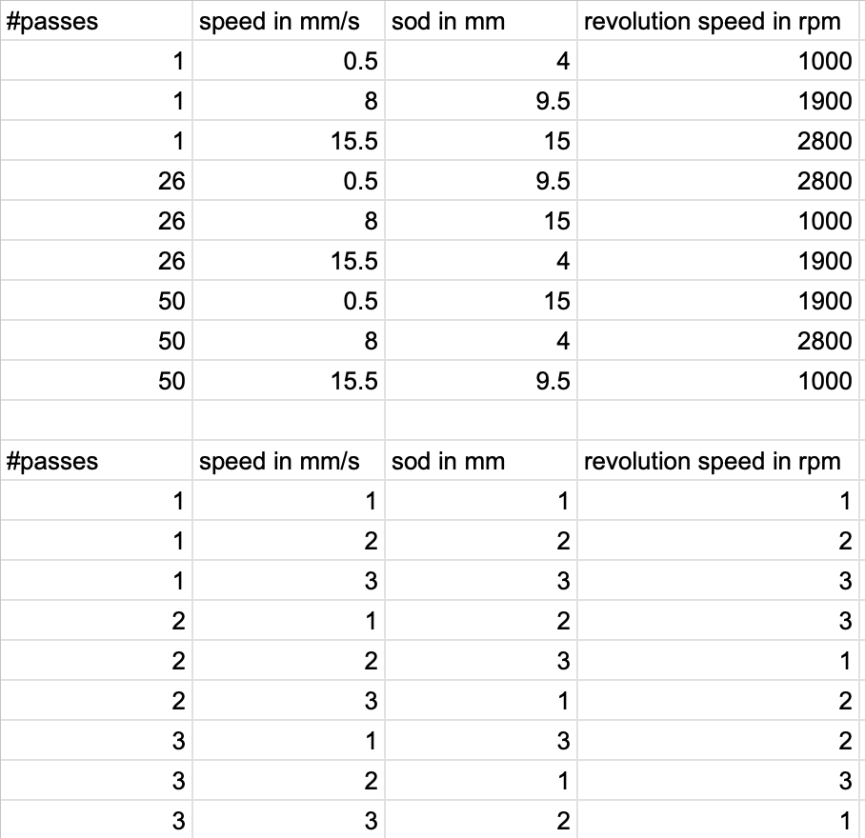
New DoE for PEEK

Slide 72
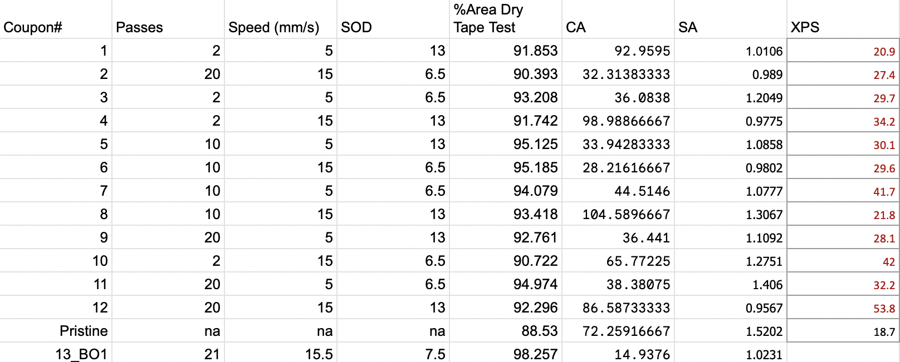

Contact Angle and Surface Roughnes Data
Smallest value of contact angles achieved
Surface roughnes shows unpredictable trend, it showed earlier also

Slide 73
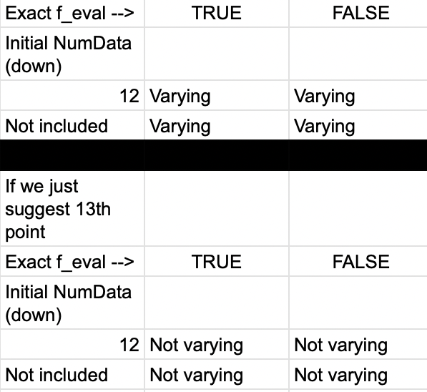
New suggestion on evry re run
F_eval
More information to the surrogate
Fixing a random seed solves the problem, but would it affect the performance?

